Slide 1
Don’t believe everything you think
(Thubten Chodron)

Slide 2
What do firms do?
Identify needs and wants of stakeholders
Produce goods and services to satisfy those needs
Generate transactions through which the need is satisfied
In the course of the transaction, create value for all parties.

Slide 3
The producer’s idea of value
The cost of making and selling the product or service (including the labour theory of value)
An estimation of what the customer is willing to pay for it
What the producer believes the product or service is intrinsically worth
But do these represent real value?

Slide 4
The consumer’s idea of value
The ‘bundle of benefits’
the satisfaction both physical and emotional that the consumer receives from making the purchase
purchasing decisions are not always rational
Will this product or service give me value that is worth the money I am paying for it?
Is it safe? Will consuming it harm me or my family?
Does it meet my physical needs?
Does it meet my psychological and aspirational needs?

Slide 5
The risks the consumer takes
In many (most?) cases, consumers do not have perfect information
Lack of information and knowledge about a product creates a perception of risk
Risk creates uncertainty
Uncertainty makes people hesitate to purchase
The higher the price, the greater the risk

Slide 6
Hidden costs (externalities)
Of course, externalities don’t just affect the consumer.
Examples: passive smoking, air pollution, corruption, low wages, poor working conditions
In many cases, the benefits enjoyed by the consumer are counter-balanced by costs born by others in society

Slide 7
Trust
Is the consumer aware of the externalities and risks when making the purchase?
Or are the risks and externalities only apparent during and after consumption?
Does the customer have sole responsibility? Caveat emptor?
What if any are the responsibilities of the producer?

Slide 8
What is value?
Value is not the same as price, or cost
Value is determined by the benefits a product or service gives (utility)
This includes both economic value and social value. The two cannot be separated.
Any organisation, private, public or third sector, profit or non-profit, lives or dies by whether it is creating value, and for whom

Slide 9
Value
Value is the measure of the total benefit provided, economic and social
Typically seen as a bilateral transaction, but should be seen in terms of the value created for all stakeholders
Failure to create value for one stakeholder leads to externalities

Slide 10
Stakeholders
‘A person, group or organisation that has interest or concern in an organisation’ (Post et al., Redefining the Corporation, 2002)
A stakeholder is any entity that is affected by the organisation and its operations, positively or negatively.

Slide 11
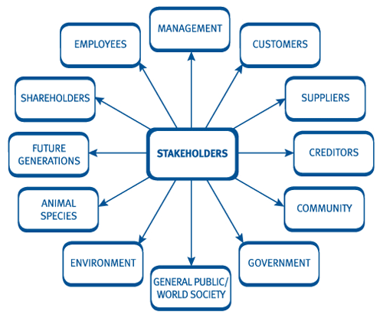
Stakeholders

Slide 12


Slide 13


Slide 14






Slide 15

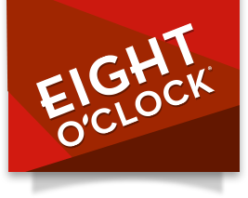







Slide 16
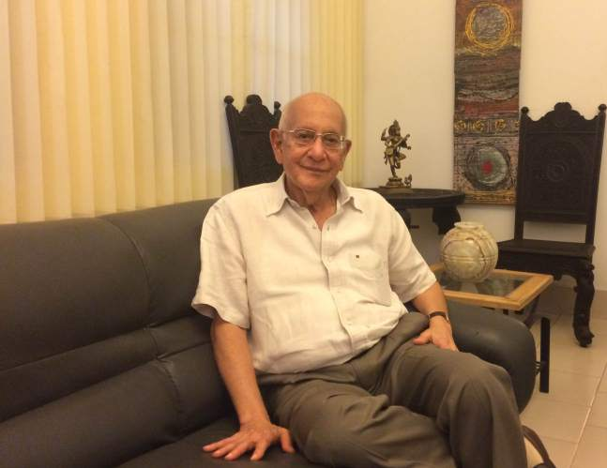

Slide 17
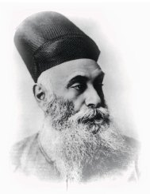

Slide 18
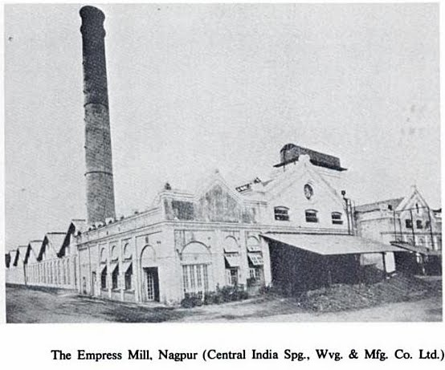

Slide 19
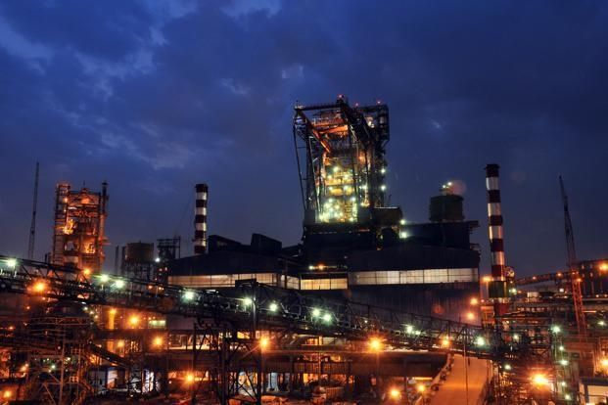

Slide 20
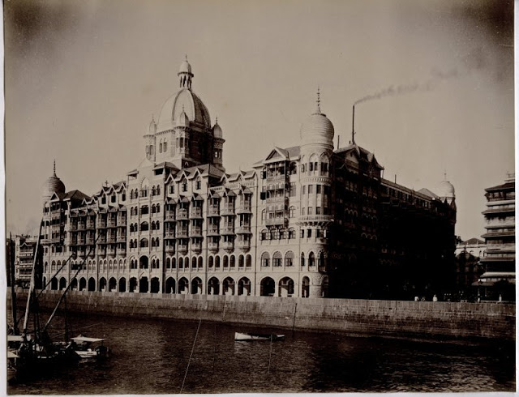

Slide 21
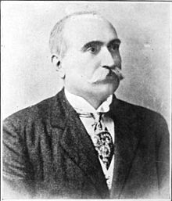

Slide 22
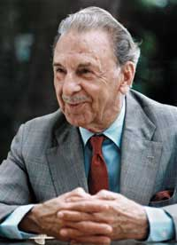

Slide 23


Your arrival was much awaited, @airindiain
. #AirIndiaOnBoard #ThisIsTata

Slide 24


Slide 25
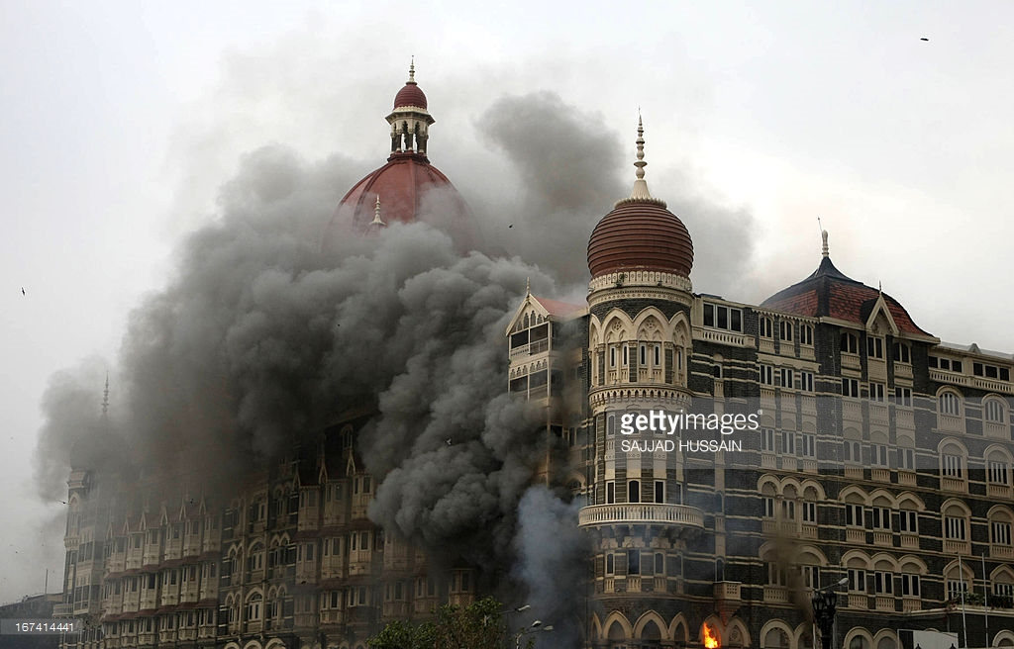

Slide 26
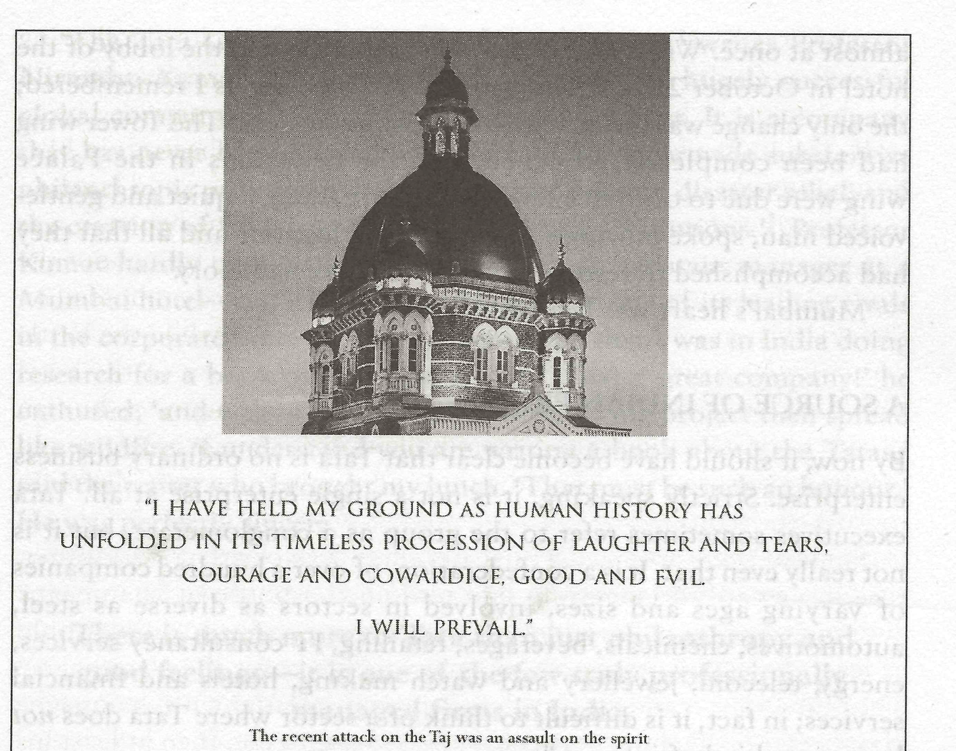

Slide 27
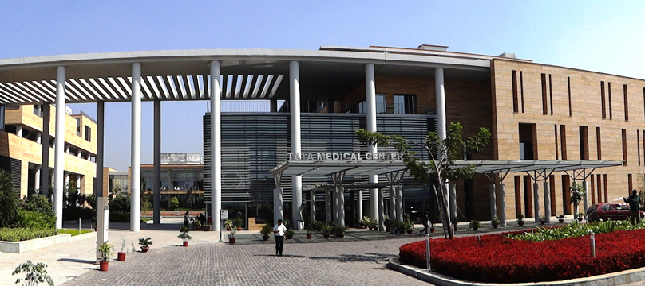

Slide 28
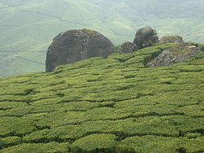

Slide 29


Slide 30
So, how do they do it?
How does Tata make money? Where does it come from? Don’t think about profits at this stage, think about value.

Slide 31
A very simple introduction to complexity
What is the difference between something that is complex and something that is complicated?

Slide 32
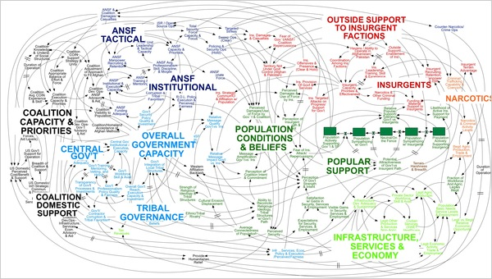

Slide 33
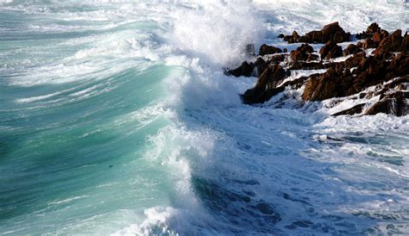

Slide 34
Process versus object
Objects are simple and static
Processes are complex and dynamic across time and space
Processes are what link objects to each other
Heraclitus: ‘no one ever steps in the same river twice, for it is not the same river and they are not the same person’
Are organisations objects, or are they processes?
And finally, all processes are driven by energy

Slide 35
Origins of complexity thinking
Heraclitus of Ephesus – ‘nothing endures but change’
World War II anti-aircraft fire control systems
‘Disorganised complexity’ and ‘organised complexity’ (Weaver 1947)
Cybernetics, the use of control and feedback mechanisms (Wiener 1948)
‘The unavoidability of hierarchies in complex systems’ (Simon 1956)

Slide 36
Disorganised and organised complexity
Disorganised: systems with very large numbers of parts, which interact apparently at random
Examples: the movement of galaxies, the movement of sub-atomic particles
Heraclitus of Ephesus (d. 475 bc)
Interactions can be understood through mathematical predictions, probability, chaos theory
Organised: systems with very large numbers of parts where the interactions are non-random
Examples: governments, ecosystems, animal swarms and ant colonies, the human brain, firms and markets
Complex adaptive systems

Slide 37
Complex adaptive systems
Properties:
The ability to self-organise; local organisations emerge without conscious direction from the centre
Emergence, whereby the interaction of the parts produces something greater than the sum of those parts; synergy
Homeostasis, an internal balance achieved through self-regulation rather than any directed form of regulation
Communication and cooperation, taking place at all levels
A high degree of adaptive capacity, leading to high levels of resilience
Can be a variety of structures: cellular, networked, hierarchical, but more likely have features of all three

Slide 38
Why do firms need to be complex (1)?
Greater resilience in the face of threats:
The Medici Bank in the 15th century was organised as a series of interlocking partnerships
Asian diversified conglomerates have cross-shareholdings that able them to defend each other in case of threat

Slide 39
Why do firms need to be complex? (2)
Greater flexibility to pivot and take advantage of opportunities:
Autonomy and localised decision-making enable faster decision making, while local control of resources means they can be deployed more quickly
Ukrainian army

Slide 40
Why do firms need to be complex? (3)
Greater collaboration because the parts have feedback loops and communications systems like neural networks that keep them connected:
Covid research and vaccine research
Google
McKinsey & Company

Slide 41
Dangers
If the parts stop interacting and begin moving together at random, the result will be loss of synergy
Communications breakdowns and loss coordination will lead to higher internal transaction costs
Flexibility turns to rigidity, smooth relationships to stressful ones
Rifts in the organisation can be exploited by people seeking personal power or advantage
The results of all interactions become unpredictable, like bowling with hand grenades

Slide 42
Managing complex systems is like herding cats
How do we lead and manage complex systems?
What do we need to do so successfully?
What provides the energy that keeps those systems moving and keeps the processes running?
(Definition of ‘successfully’: preventing organised complex systems from turning into disorganised ones)

Slide 43
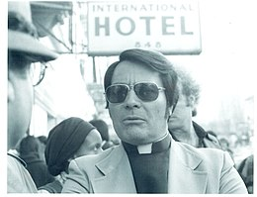
Dark leadership

Slide 44
Dark leadership
Toxic leadership
Narcissistic leadership
Effect on organisations and people within them
Effect on society and the world at large
Why do people follow dark leaders?
Herd instinct (Mackay 1841)
Charisma
Need to believe in someone/something

Slide 45
Characteristics of dark leaders
They rarely take blame or share glory.
They are not toxic all the time, or to all people.
They are rarely if ever toxic when in the company of “the boss.”
They sometimes have good ideas and accomplish good things.
They can be charming when the occasion fits.
They are frequently described as extremely bright and hard-working.
They are often highly energetic and have a reputation for getting things done.
They often have a coterie of devoted “fans” who keep appearing on their staffs.
Most have been seen as toxic by subordinates since early in their career.
Their boss either does not know or pretends not to know, and almost never records, their abuse of subordinates.
(Boisselle and McDonnell 2014)
Also, they have no compunction about deceiving other people; lying, or at least not telling the full truth

Slide 46
Dark leadership archetypes
The obsessive-compulsive leader
The narcissistic leader
The fearful leader
The malignant leader
The antisocial leader
The cynical leader
The despotic leader
(McIntosh and Rima 2007; Furnham 2010)

Slide 47
Dark leadership
Dark leaders are never alone
They rely on a coterie of followers who share their worldview
While there may be rivalries within this group, ultimately the group is bound together by commonly held values and a need to stand united against the ‘other’
Loyalty to the leader is thus both a matter of ideology and self-interest
(Kets de Vries 2004)

Slide 48
Responses to dark leadership
Surrender to the dominant ethos, no matter what it is
Fight: build coalitions against dark leadership
Flight: exit the organisation, do something else
Choose the hill you want to die on

Slide 49
Discussion
How do we prevent dark leaders from emerging in the organisation?
How do we guard and maintain the organisation’s values so they cannot be subverted?
Could we become dark leaders? Is there the potential for dark leadership in all of us, and what do we do about this?

